Slide 1
IRB (Institutional Review Board)
Prof. Susanna Berkouwer
Pre-doc Training, August 2024

Slide 2
What are the goals when submitting IRB?
Ensure ethical treatment of research subjects
Obtain approval from the Penn IRB review board
Ensure ethical treatment of research subjects
Ensure compliance with legal requirements
Ensure all research is in line with Penn’s values
[If applicable] Obtain approval from a foreign review board

Slide 3

Practical stuff
Complete CITI training (or transfer from old institution):
https://irb.upenn.edu/mission-institutional-review-board-irb/guidance/citi-human-research-protections-training
Website to submit IRB: https://irb.upenn.edu/

Slide 4
Putting together an IRB application
Study protocol
Research question & motivation
Recruitment pool & method
Process:
mode and content of surveys
random treatments
Risk to participants
Data protection measures
Cover letter
Attachments
Consent forms
Survey instruments
International approvals
Funding sources
CITI certificates

Slide 5
Data Visualization & Latex
Prof. Susanna Berkouwer
Pre-doc Training, August 2024

Slide 6
Communicating research
Prof. Susanna Berkouwer
Pre-doc Training, August 2023

Slide 7
Today
Graphing
Labelled: x-axis variable name, y-axis variable name, title
Scaled: y-axis should (almost*) always start at 0
Footnoted: How was the variable created?
Tables
Latex
Organizing your research output

Slide 8
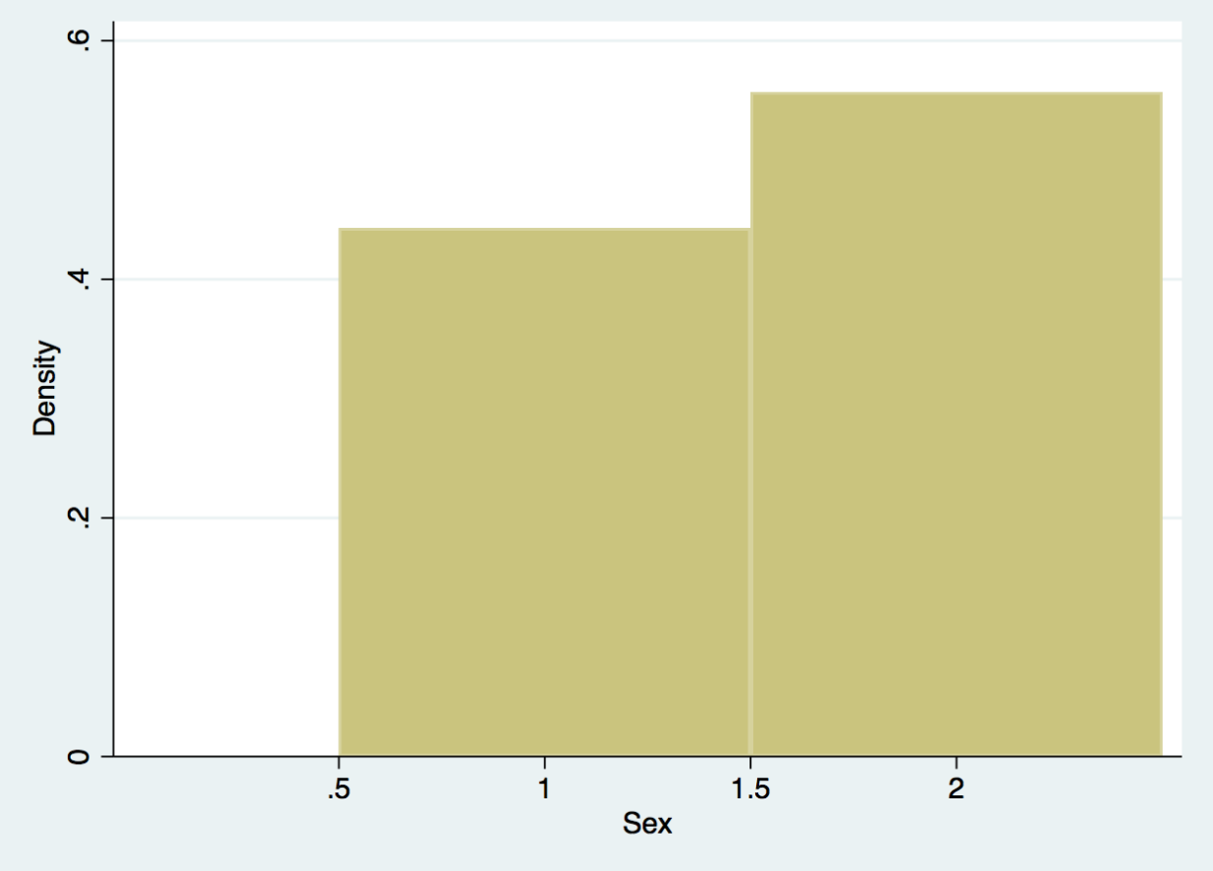
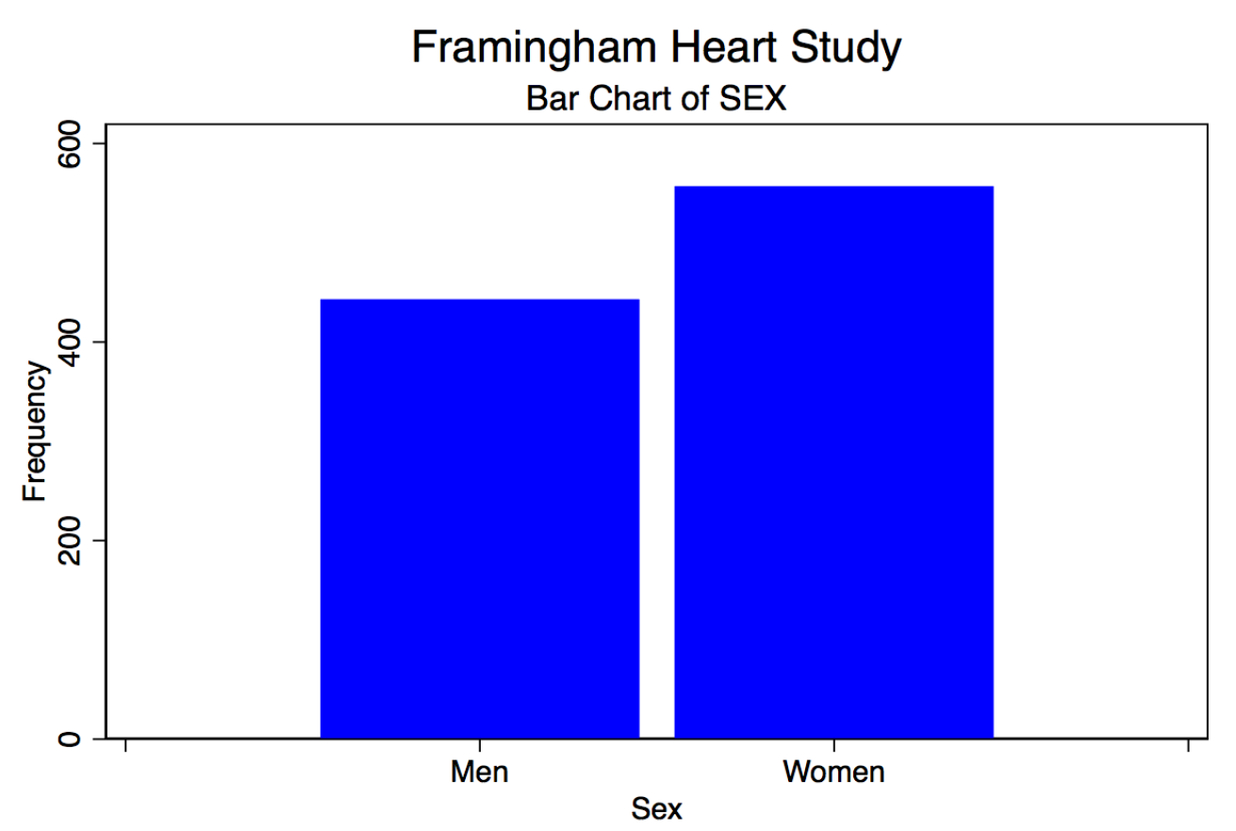
What should a histogram convey?
Data Visualization w Stata (UMASS guide)
What variable is on the x-axis? Is this continuous or discrete?
What is the sample size?
Where does the data come from?
What do the values mean?

Slide 9
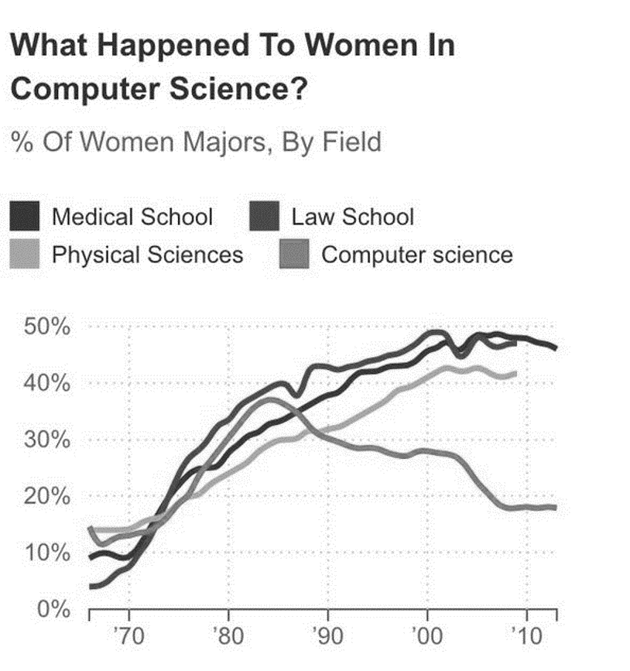
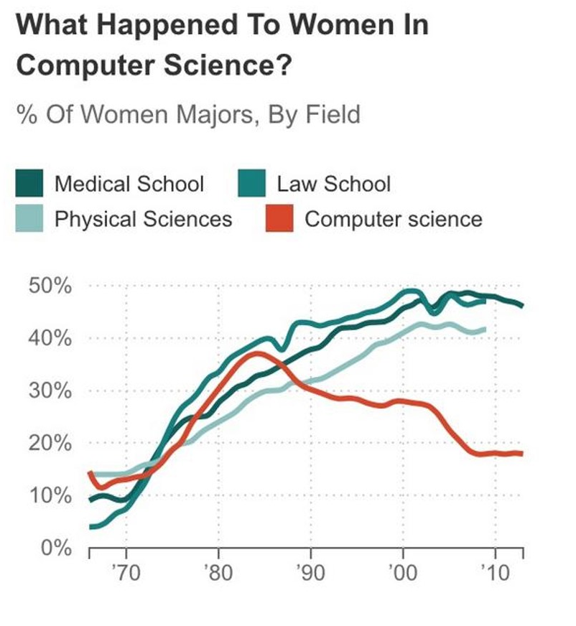
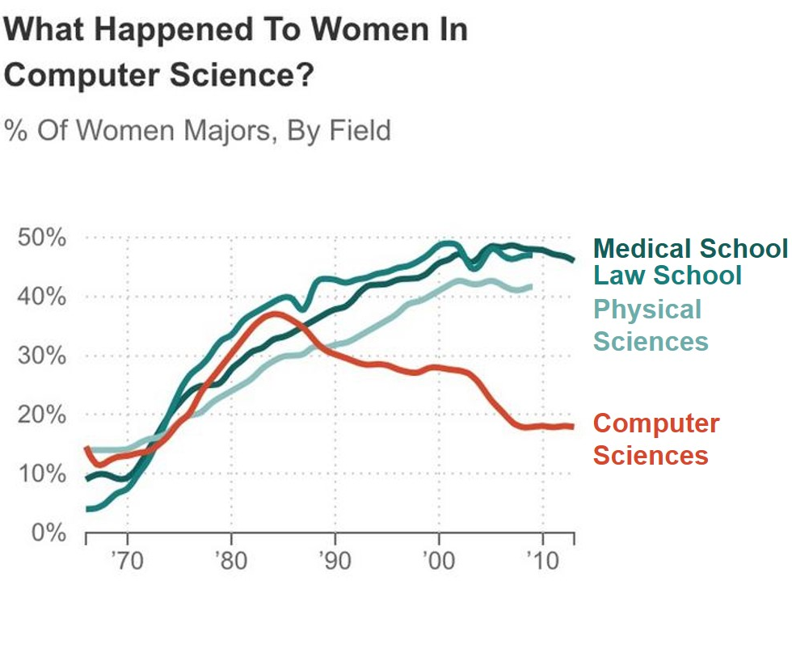
Label lines with quick legibility in mind
Ann K. Emery, depict data studio
(https://depictdatastudio.com/directly-labeling-line-graphs/)

Slide 10
Other important notes
Graphs should be legible for color-blind folks and with a grayscale printer
https://colorbrewer2.org/#type=qualitative&scheme=Dark2&n=3

Slide 11
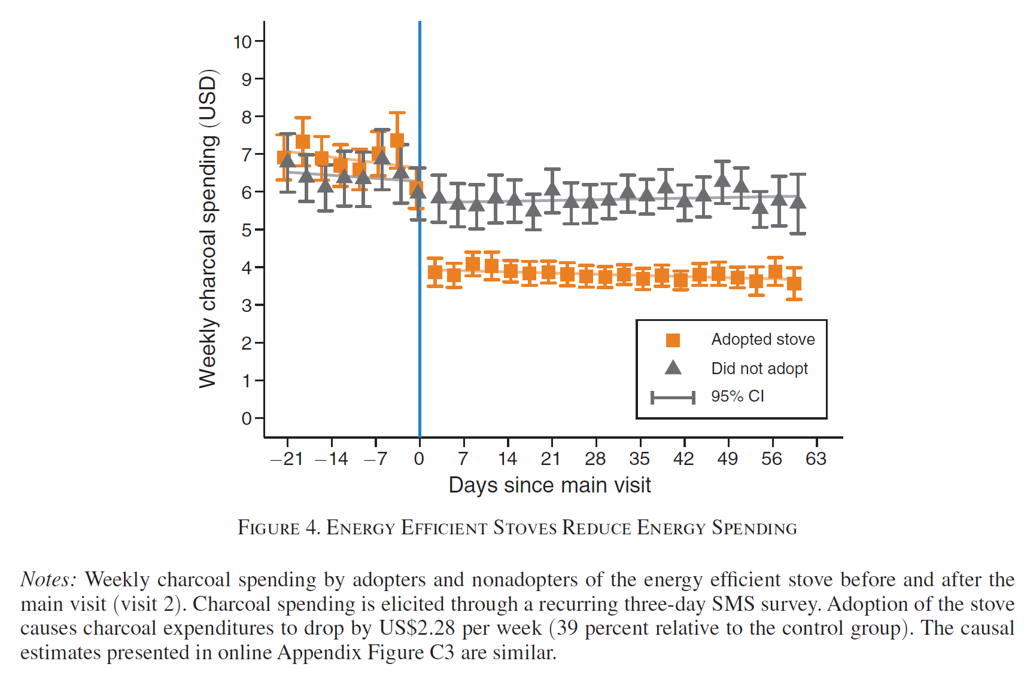
Coding in practice (Berkouwer & Dean; AER, 2022)
1 key take-away: “after main visit, spending dropped for adopters”
1 key point in time:
‘Main visit’
2 key groups:
Adopters
Non-adopters
3 key components:
Means (by day + adoption)
Confidence Intervals
Lines of best fit

Slide 12
Footnotes convey crucial information about variables

Slide 13
(Ask your PI / other pre-docs for code)
twoway (lfit mean CsinceV2 if jikokoa==0 & CsinceV2<=0, lcolor(gs10) connect(l)) ///
(lfit mean CsinceV2 if jikokoa==0 & CsinceV2> 1 , lcolor(gs10) connect(l)) ///
(lfit mean CsinceV2 if jikokoa==1 & CsinceV2<=0, lcolor(dkorange*0.5) connect(l)) ///
(lfit mean CsinceV2 if jikokoa==1 & CsinceV2> 1 , lcolor(dkorange*0.5) connect(l)) ///
(rcap ub lb Csince if jikokoa==1, mcolor(dkorange dkorange) lcolor(dkorange dkorange)) ///
(rcap ub lb Csince if jikokoa==0, mcolor(gs6 gs6) lcolor(gs6 gs6)) /// (scatter mean CsinceV2 if jikokoa==1, mcolor(dkorange) msymbol(S) lcolor(dkorange) lpattern(dash) connect(none)) /// (scatter mean CsinceV2 if jikokoa==0, mcolor(gs6) msymbol(T) lcolor(gs6) lpattern(shortdash) connect(none)), ///
`white' scale(1.5) ///
xline(0, lcolor(midblue)) ///
xsize(2.5) ysize(1.2) ///
yscale(range(0 `l')) ///
ylabel(#10, nogrid angle(0)) xlabel(-21(7)64, angle(0)) ///
ytitle("Weekly charcoal spending (`c')") ///
xtitle("Days since main visit") ///
legend(cols(1) pos(3) label(8 "Did not adopt") label(7 "Adopted stove") label(6 "95% CI") order(7 8 6) region(lcolor(white)) )

Slide 14
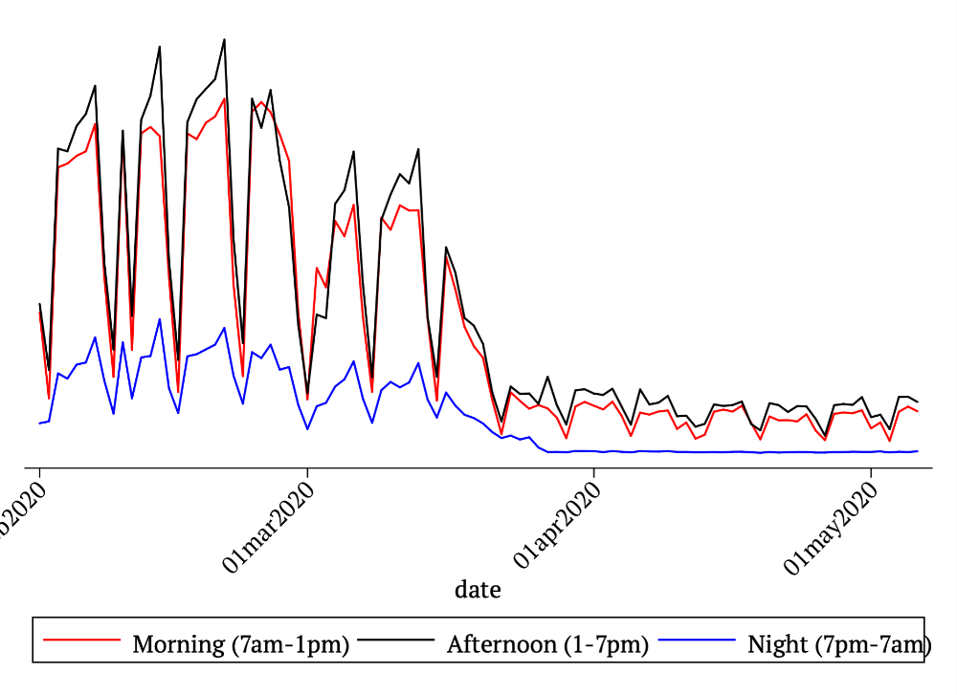
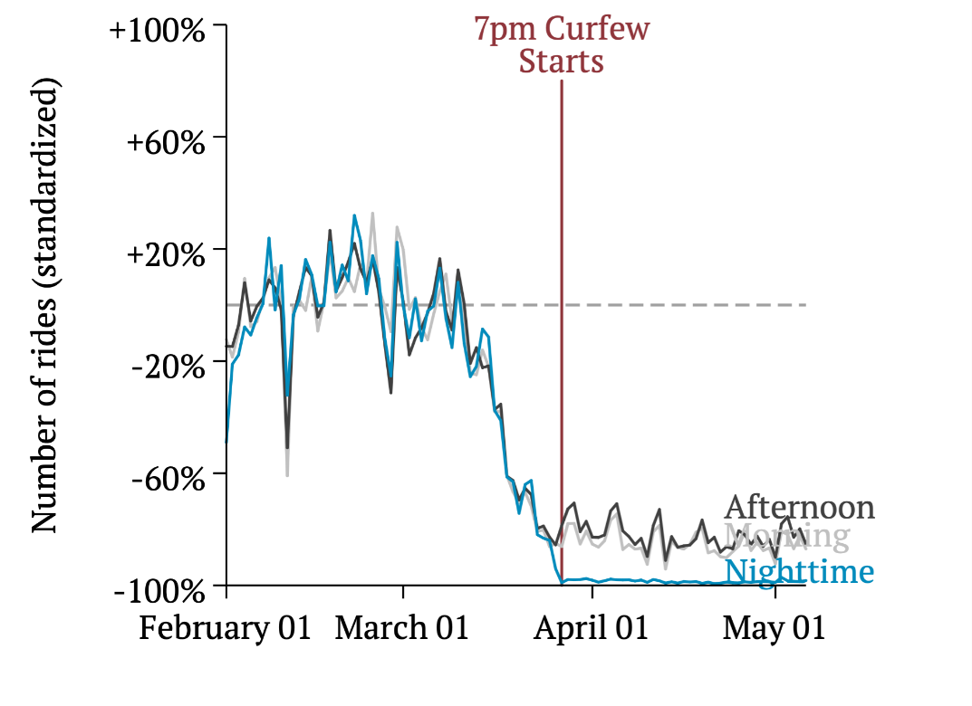
Label lines with quick legibility in mind
Berkouwer & Eggers (2020)

Slide 15
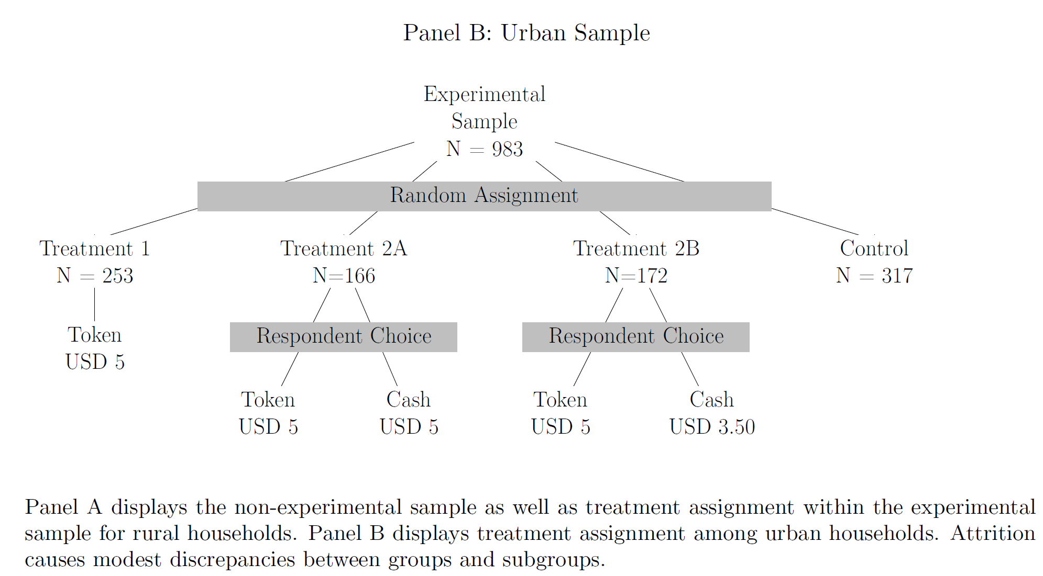
Tikz for graphs (Latex)
Berkouwer, Biscaye, Hsu, Kim, Lee, Miguel, Wolfram (2021)

Slide 16
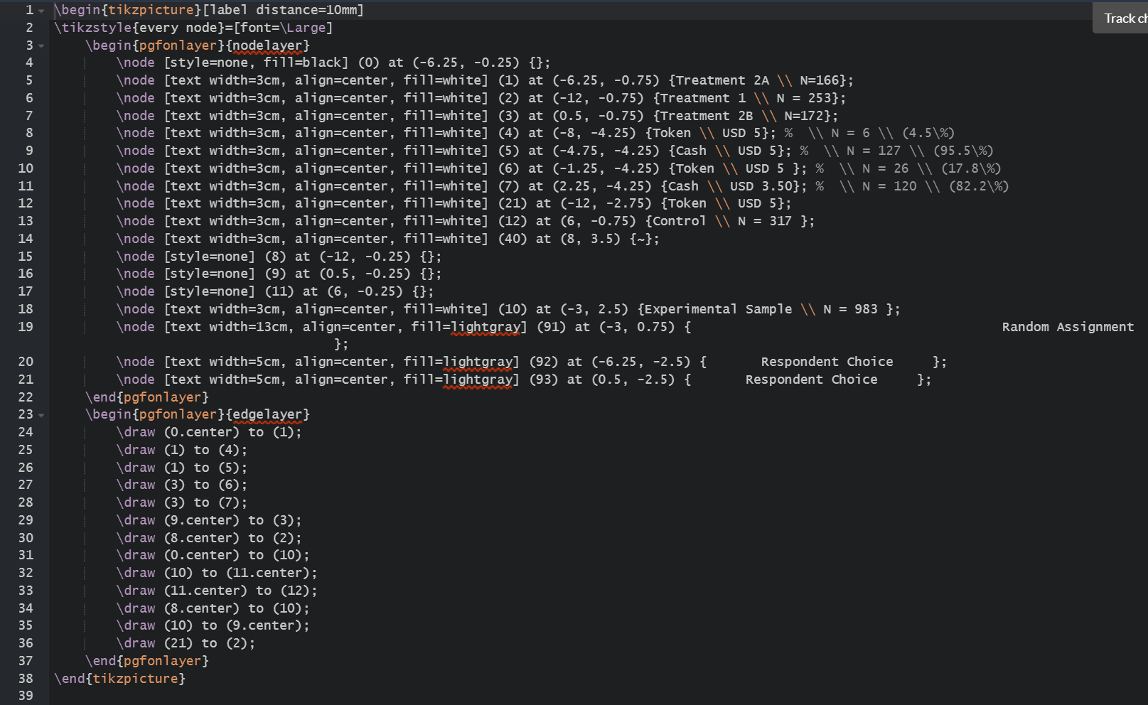
Tikz for graphs (Latex)
Define labelled nodes
Some invisible nodes too:
Add decision rectangles
Connect nodes with lines

Slide 17
Today
Graphing
Tables
Latex
Organizing your research output

Slide 18
What should a table convey?
Berkouwer & Dean (AER, 2022)

Slide 19
What should a table convey?
Data source
How variables were constructed
Sample size
Regression specification
e.g. OLS, IV
Outcome variable
Independent variables
Other controls (fixed effects, controls)
Significance
Stars (some journals don’t allow this anymore!)
Standard errors

Slide 20
Today
Graphing
Tables
Latex
Organizing your research output

Slide 21
Installing LaTeX
Install a TeX distribution (TeX Live, MiKTeX, or MacTeX)
Install an editor (Lyx, TeXmaker, or other)
Export to PDF

Slide 22
Installing LaTeX
Install a TeX distribution (TeX Live, MiKTeX, or MacTeX)
Install an editor (Lyx, TeXmaker, or other)
Export to PDF
Just use Overleaf.com

Slide 23
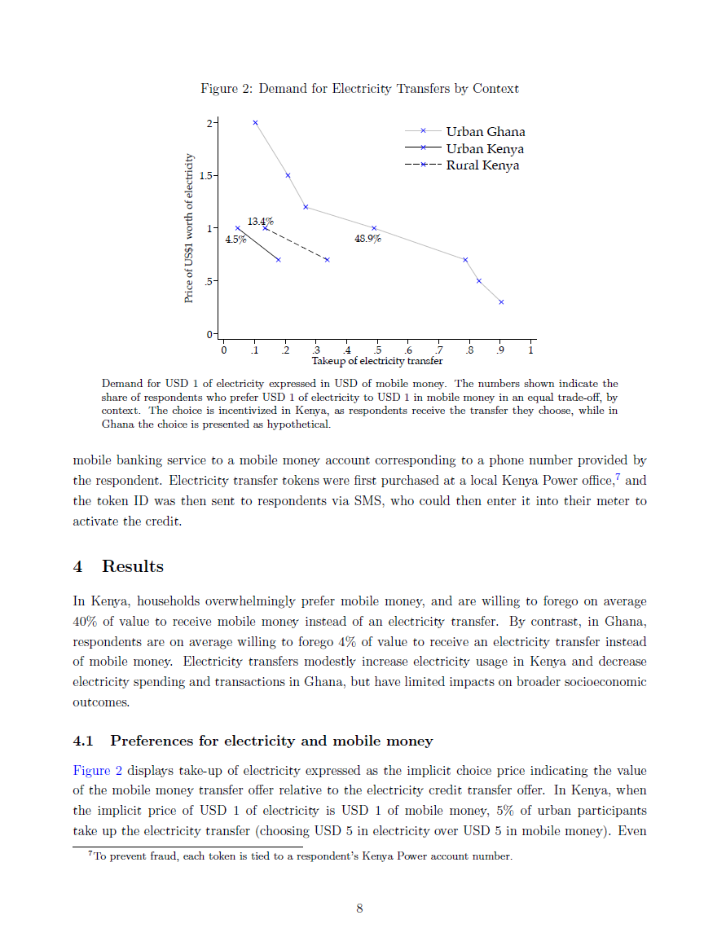
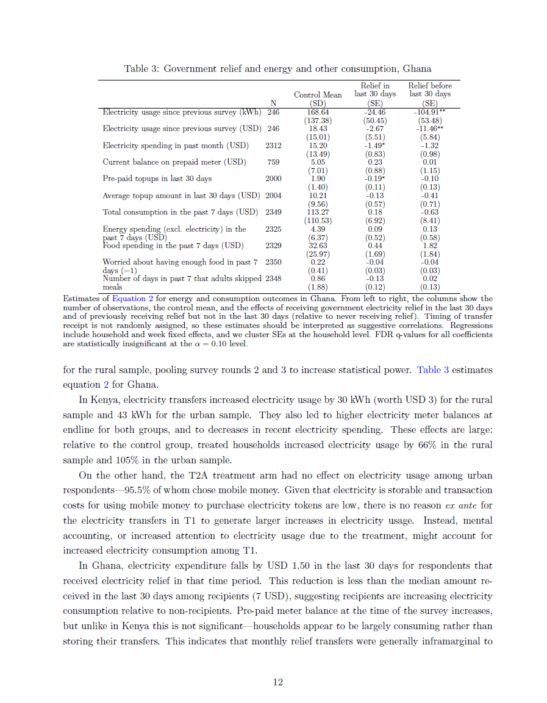
Calling the graphs & tables you made

Slide 24
Calling graphs you made (ask your PI / other pre-docs for code)
\begin{figure}[h]
\caption{Energy efficient stoves reduce energy spending}
\begin{flushright}
\begin{minipage}{0.9\textwidth}
\label{fig:diffindiff}
\includegraphics[width=1\textwidth]{"Images/DiffInDiffCharcoal_USD_PAPER".pdf}
\end{minipage}
\end{flushright}
\justify \footnotesize Weekly charcoal spending by adopters and non-adopters of the energy efficient stove before and after the main visit (visit 2). Charcoal spending is elicited through a recurring 3-day SMS survey. Adoption of the stove causes charcoal expenditures to drop by USD 2.27 per week (40 percent relative to the control group). The causal estimates presented in \autoref{fig:diffindiffIV} are similar.
\end{figure}

Slide 25
Calling tables you made (ask your PI / other pre-docs for code)
Added in Latex
What you made in Stata/R
Added in Latex
Berkouwer & Dean (AER, 2022)

Slide 26
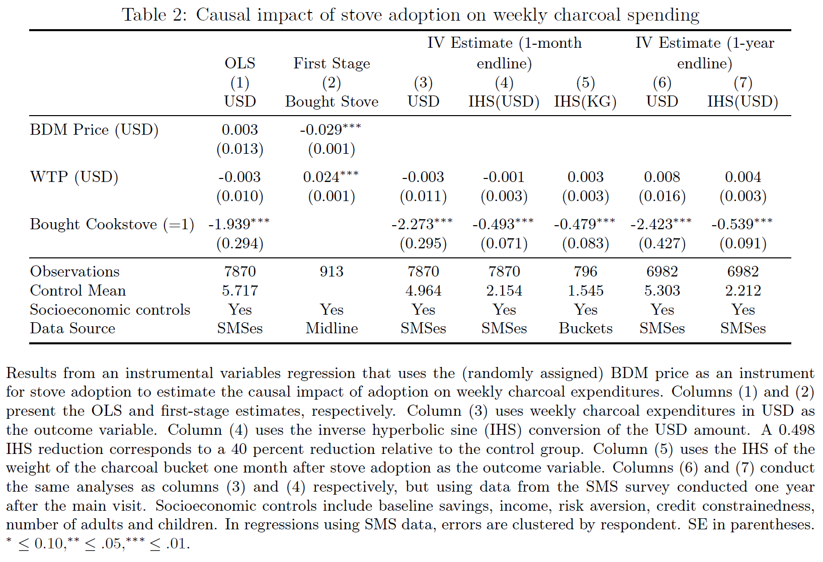
Calling tables you made (ask your PI / other pre-docs for code)
\begin{table}[h]
\begin{center}
\caption{Causal impact of stove adoption on weekly charcoal spending} \label{tab:ivresults}
\addtolength{\tabcolsep}{-5pt}
\begin{tabular}{@{\extracolsep{6pt}}lccccccccc}
\toprule
\input{Tables/IVcharcoal_PAPER.tex}
\bottomrule
\end{tabular} \\
\end{center}
\footnotesize Results from an instrumental variables regression that uses the (randomly assigned) BDM price as an instrument for stove adoption to estimate the causal impact of adoption on weekly charcoal expenditures. Columns (1) and (2) present the OLS and first-stage estimates, respectively. Column (3) uses weekly charcoal expenditures in USD as the outcome variable. Column (4) uses the inverse hyperbolic sine (IHS) conversion of the USD amount. A 0.498 IHS reduction corresponds to a 40 percent reduction relative to the control group. Column (5) uses the IHS of the weight of the charcoal bucket one month after stove adoption as the outcome variable. Columns (6) and (7) conduct the same analyses as columns (3) and (4) respectively, but using data from the SMS survey conducted one year after the main visit. Socioeconomic controls include baseline savings, income, risk aversion, credit constrainedness, number of adults and children. In regressions using SMS data, errors are clustered by respondent. SE in parentheses. ${^*}\leq0.10, ^{**}\leq.05, ^{***}\leq.01$.
\end{table}

Slide 27
Today
Graphing
Tables
Latex
Organizing your research output

Slide 28
Organizing your research output
Challenge:
Many datasets with many variables and many ways of cleaning them
Many draft versions that may not make it into the paper
Many regressions
Many analyses
Many revisions of old analyses
Solution:
Label and describe everything
Date everything
e.g. a continuously updated PDF with versions of results

Slide 29
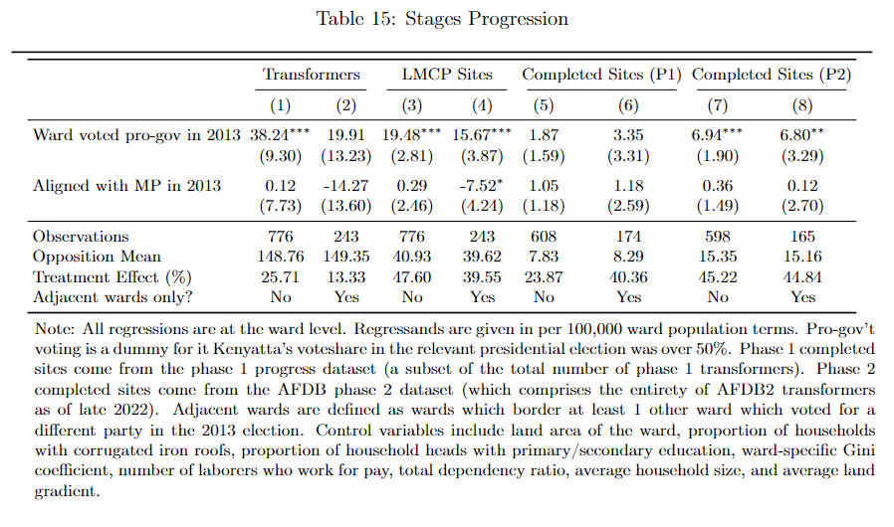
The research process is revise, revise, revise
Is each regression OLS/IV/…?
What is the outcome variable?
Which sample did you use?
How did you construct variables?
What control variables did you include?
What fixed effects and clustering are included?

Slide 30
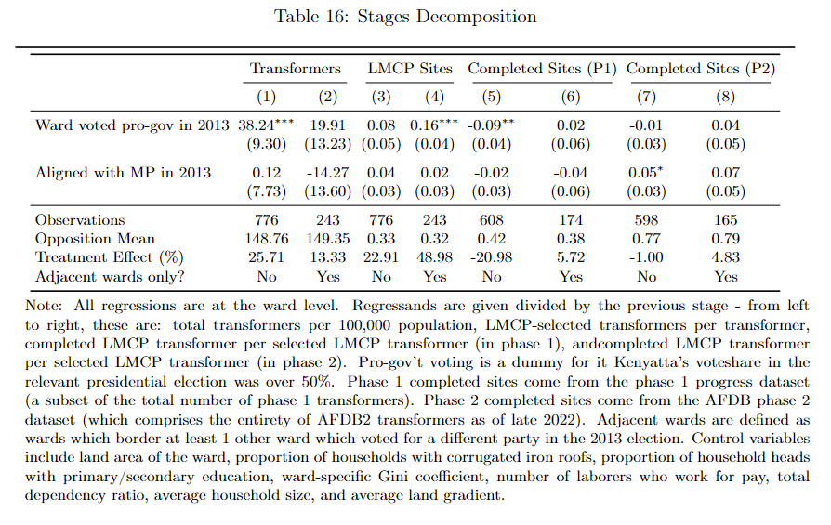
The research process is revise, revise, revise
Is each regression OLS/IV/…?
What is the outcome variable?
Which sample did you use?
How did you construct variables?
What control variables did you include?
What fixed effects and clustering are included?

Slide 31
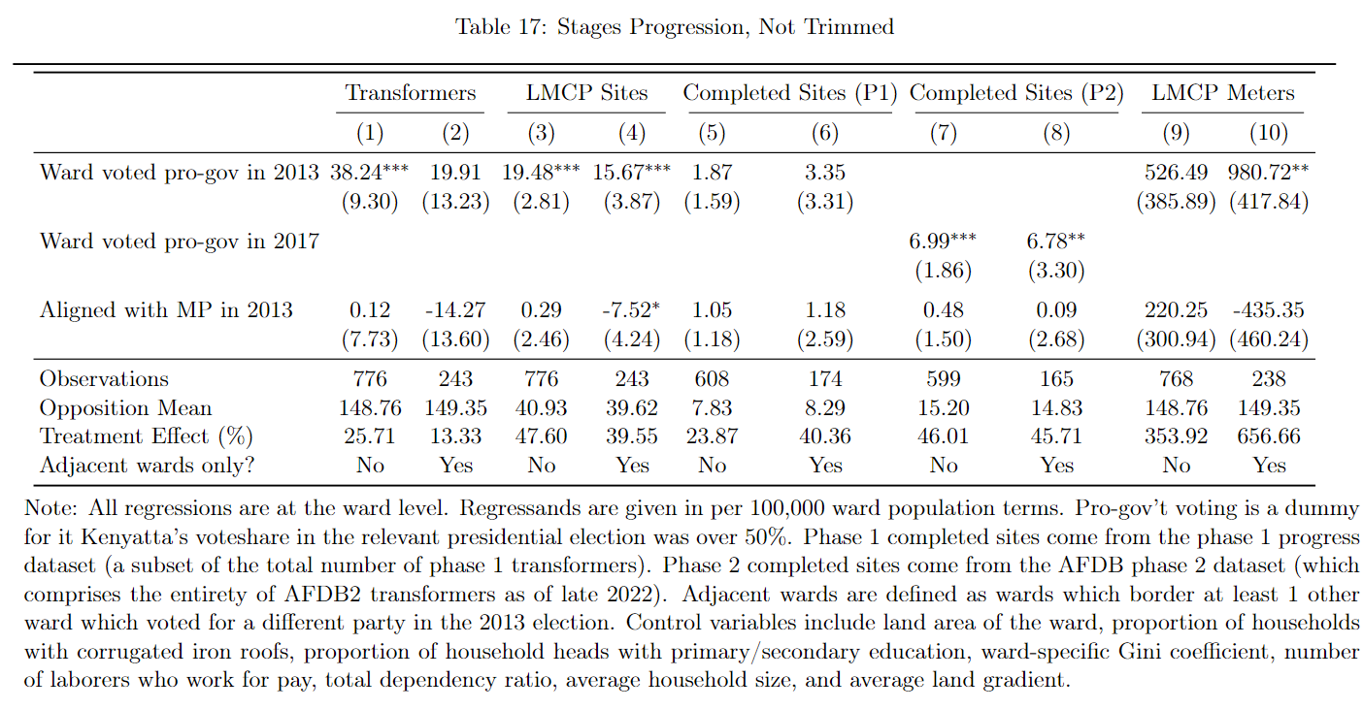
The research process is revise, revise, revise
Is each regression OLS/IV/…?
What is the outcome variable?
Which sample did you use?
How did you construct variables?
What control variables did you include?
What fixed effects and clustering are included?

Slide 32
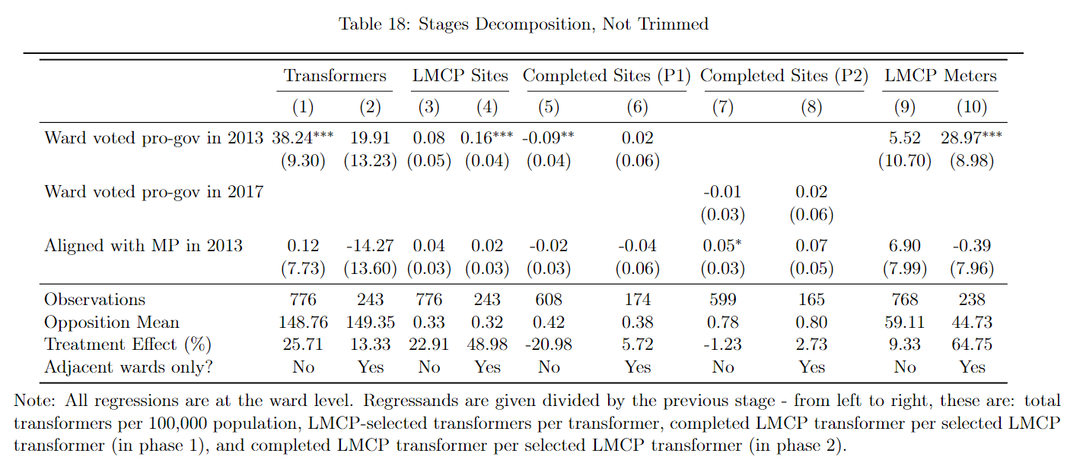
The research process is revise, revise, revise
Is each regression OLS/IV/…?
What is the outcome variable?
Which sample did you use?
How did you construct variables?
What control variables did you include?
What fixed effects and clustering are included?

Slide 33
Replication datasets for journals
One folder that can be zipped and posted online
All survey instruments (if applicable)
Raw data only
No confidential information
Code to produce medium and clean datasets
Code to produce all the paper’s graphs and tables
Code to run all the code
Standardized locals and globals to manage directories
List of all required packages
ReadMe files

Slide 34
A replication dataset has 5 key folders
DATA
RAW
.xlsx, .csv, .txt, .doc, .pdf, etc. (direct download from website/research partner)
MEDIUM
.dta, .r (imported, merged, cleaned of typos)
CLEAN
.dta, .r, (variables used in analysis)
DO
Master file with paths and settings (.do, .R, etc.)
Cleaning file(s) (.do, .R, etc.)
Analysis file(s) (.do, .R, etc.)
SURVEYING INSTRUMENTS
Baseline survey (word/excel)
Endline survey (word/excel)
PACKAGES
.ado
RESULTS
GRAPHS
.eps, .pdf, .png
TABLES
.tex
MAPS
.eps, .pdf, .png
ReadMe.docx (sources of raw data files, explanation of files)
RunAll.do, RunAll.R (replicates entire project)

Slide 35



